Slide 1
PI-DAEs – Physics-informed Denoising Autoencoders
Antonio Liguori – 19. March 2023

Slide 2
Motivation
Statistical approach
Linear interpolation
Mean operation
Machine learning
KNNimpute
MissForest
Deep learning
Denoising Autoencoders (DAEs)

Slide 3
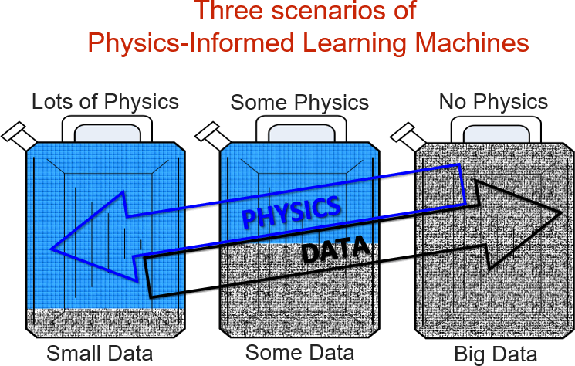
Motivation
Significant progress for deep learning in recent years
Extensive historical data
Physics-informed Neural Networks (PINNs), i.e., solution and identification (discovery) of physical systems
Fig. 1. Data vs physics.

Slide 4
Motivation
Pros and cons of DAEs for missing data imputation
Reflect the non-linear characteristics of the missing building monitoring data
Require extensive historical data for training
Benefits of Physics-informed DAEs (PI-DAEs) for missing data imputation
Combine the potential of DAEs with mathematical models based on physicals laws as differential equations
Can be used for both parameter estimation and imputation

Slide 5
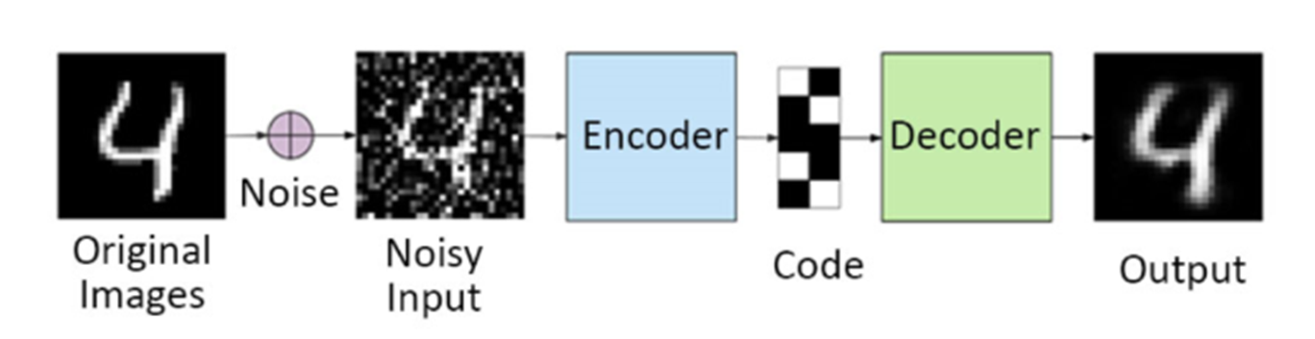
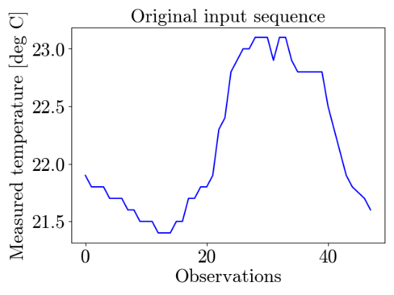
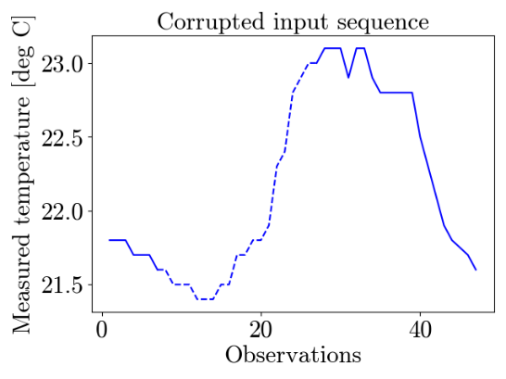
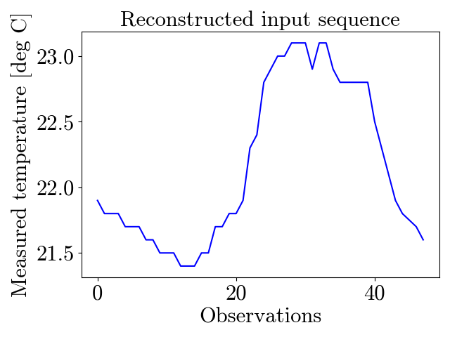
Theoretical background – DAEs
DAEs were first used for image denoising in computer vision
Fig. 2. Training of a generic denoising autoencoder applied to computer vision (top) and building monitored data (bottom).

Slide 6
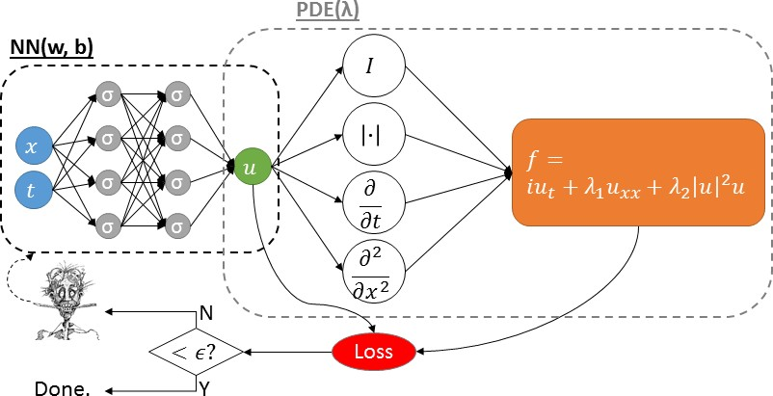
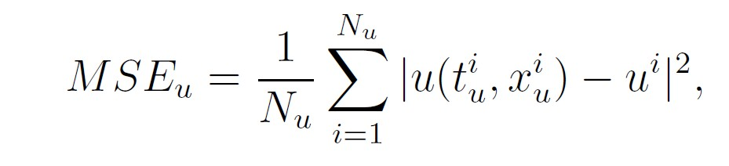
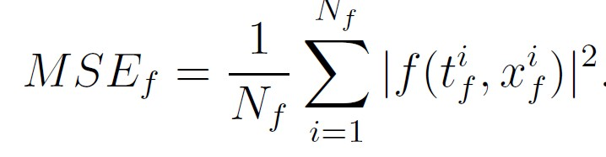

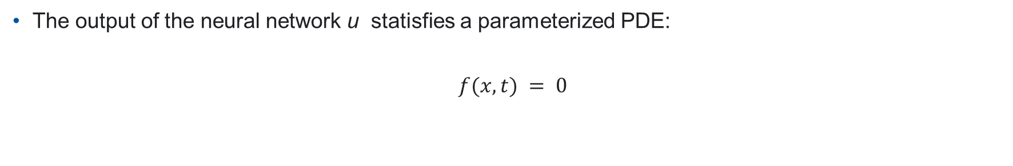
Theoretical background – PINNs
The output of the neural network u statisfies a parameterized PDE:
$$f(x,t) = 0$$
Fig. 3. Representation of a generic PINN.

Slide 7

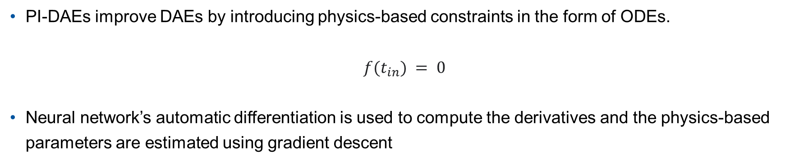
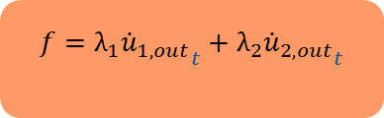




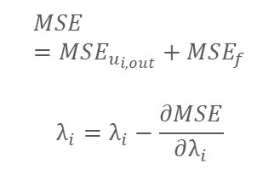



Theoretical background – PI-DAEs
PI-DAEs improve DAEs by introducing physics-based constraints in the form of ODEs.
$$f(t_{in}) = 0$$
Neural network’s automatic differentiation is used to compute the derivatives and the physics-based parameters are estimated using gradient descent
$$DAE(w,b)$$
$$ODE(λ)$$
$$t$$
$$MSE=MSE_{u_{i,out}}+MSE_{f}$$
$$λ_{i}=λ_{i}−\frac{∂MSE}{∂λ_{i}}$$
$$\frac{d}{dt}$$
$$f=λ_{1}{{\dot{u}}_{1,out}}_{t}+λ_{2}{{\dot{u}}_{2,out}}_{t}$$
$$u_{1,in}$$
$$u_{1,out}$$
$$u_{2,in}$$
$$u_{2,out}$$
Loss
Fig. 4. Representation of a generic PI-DAE.

Slide 8
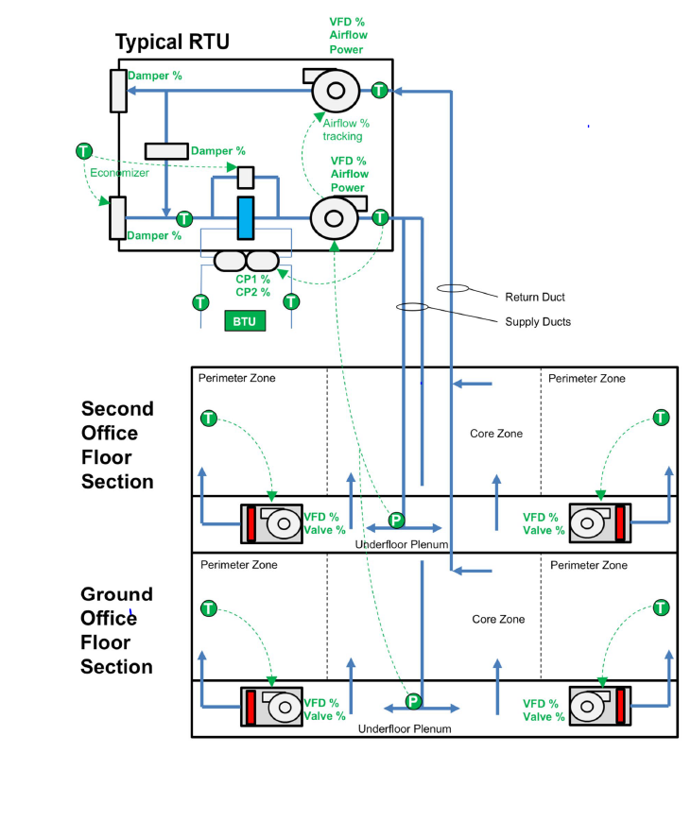
Case study description
Office building located in Berkeley, California (open-source dataset)
Each roof terminal unit (RTU) is serving one thermal zone
We aggregate temperature data at the building level using the average -> no heat flow from adjacent zones
Cooling and heating loads can be aggregated by sum
Luo, N., Wang, Z., Blum, D., Weyandt, C., Bourassa, N., Piette, M. A., & Hong, T. (2022). A three-year dataset supporting research on building energy management and occupancy analytics. Scientific Data, 9(1), 156.
Fig. 5. Building scheme.

Slide 9

Definition of the building energy balance ODE
Energy balance:
$${\dot{Q}}_{storage}=\dot{Q_{T}}+\dot{Q_{V}}+\dot{Q_{S}}+\dot{Q_{I}}+\dot{Q_{E}}$$
${\dot{Q}}_{storage}$= heat storage
$\dot{Q_{T}}$ = transmission heat flux
$\dot{Q_{V}}$ = ventilation heat flux
$\dot{Q_{S}}$ = solar heat flux $≈$ 0
$\dot{Q_{I}}$ = internal heat flux $≈$ 0
$\dot{Q_{E}}$ = evaporative heat flux $≈$ 0
$\dot{Q_{V}}$ = ${\dot{Q}}_{heat}−{\dot{Q}}_{cool}$

Slide 10
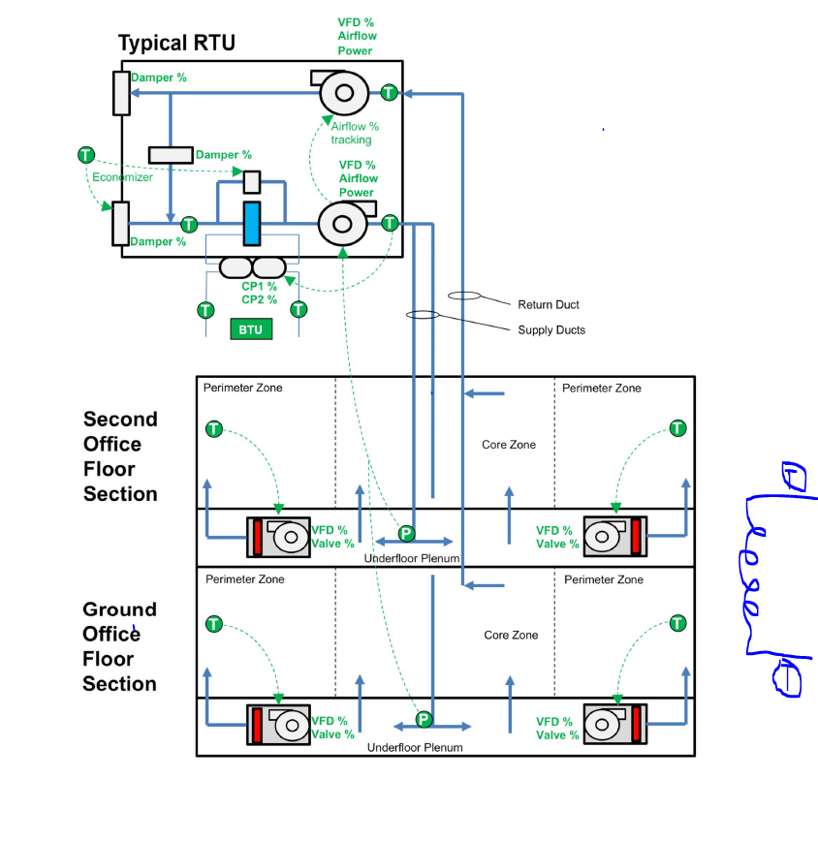

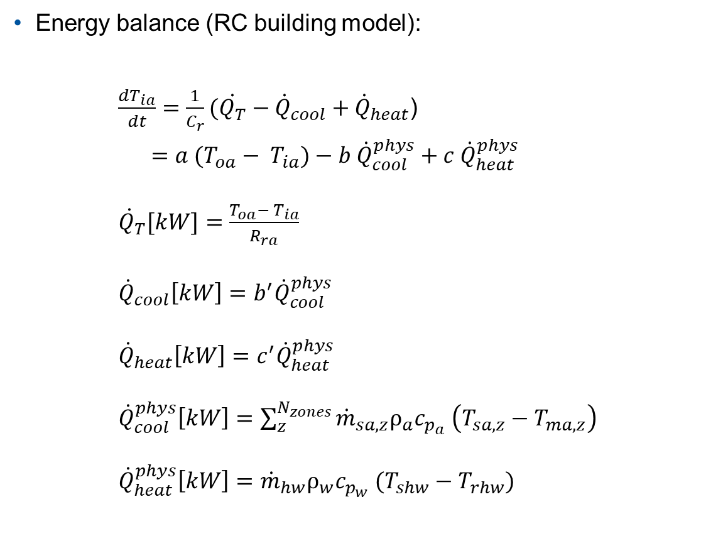







Definition of the building energy balance ODE
Energy balance (RC building model):
$\frac{dT_{ia}}{dt}=\frac{1}{C_{r}}(\dot{Q_{T}}−{\dot{Q}}_{cool}+{\dot{Q}}_{heat}$)
$=a (T_{oa}− T_{ia})−b {\dot{Q}}_{cool}^{phys}+c {\dot{Q}}_{heat}^{phys}$
$\dot{ Q_{T}}[kW]=\frac{T_{oa}− T_{ia}}{R_{ra}}$
$${ \dot{Q}}_{cool}\left[kW\right]=b^{′}{\dot{Q}}_{cool}^{phys}$$
$${ \dot{Q}}_{heat}\left[kW\right]=c^{′}{\dot{Q}}_{heat}^{phys}$$
${ \dot{Q}}_{cool}^{phys}\left[kW\right]$ $=\sum_{z}^{N_{zones}}{{\dot{m}}_{sa,z}ρ_{a}c_{p_{a}} \left(T_{sa,z}−T_{ma,z}\right)}$
${ \dot{Q}}_{heat}^{phys}\left[kW\right]$ $={\dot{m}}_{hw}ρ_{w}c_{p_{w}} (T_{shw}−T_{rhw})$
$$T_{sa}$$
$$T_{ma}$$
$${\dot{Q}}_{cool}$$
$$T_{rhw}$$
$${\dot{Q}}_{heat}$$
$$\dot{Q_{T}}$$
$$T_{shw}$$
$$T_{oa}$$
Fig. 6. Building scheme with heat fluxes.

Slide 11




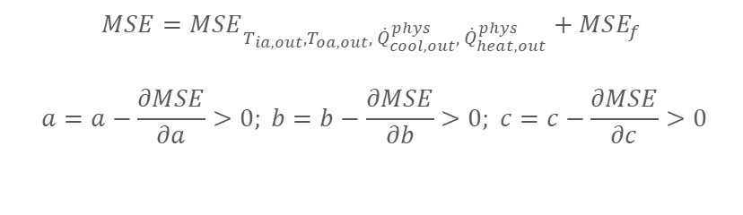








Definition of the model
Imputation of building thermal dynamics variables with missing values (except $T_{oa,in})$
$$DAE(w,b)$$
$$ODE(a,b,c)$$
$$t$$
$$T_{ia,in}$$
$$T_{ia,out}$$
$$f={\dot{T}}_{ia,out_{t} }−(a (T_{oa,out}−T_{ia,out})−b{ \dot{Q}}_{cool,out}^{phys}+c{ \dot{Q}}_{heat,out}^{phys})$$
$$T_{oa,in}$$
$$T_{oa,out}$$
$$\frac{d}{dt}$$
$${ \dot{Q}}_{cool,in}^{phys}$$
$${ \dot{Q}}_{cool,out}^{phys}$$
$${ \dot{Q}}_{heat,in}^{phys}$$
$${ \dot{Q}}_{heat,out}^{phys}$$
Loss
$$MSE=MSE_{T_{ia,out},T_{oa,out},{ \dot{Q}}_{cool,out}^{phys},{ \dot{Q}}_{heat,out}^{phys}}+MSE_{f}$$
$$a=a−\frac{∂MSE}{∂a}>0; b=b−\frac{∂MSE}{∂b}>0; c=c−\frac{∂MSE}{∂c}>0$$
Fig. 7. Representation of a PI-DAE with building energy balance ODE.

Slide 12
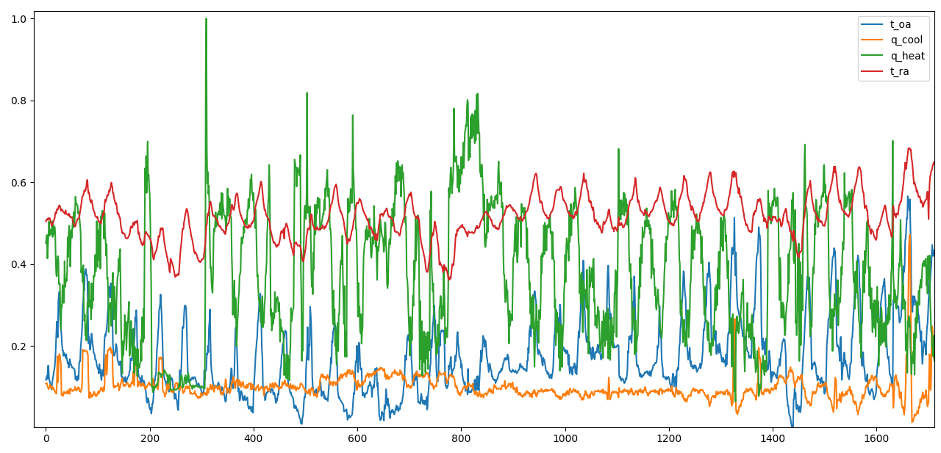
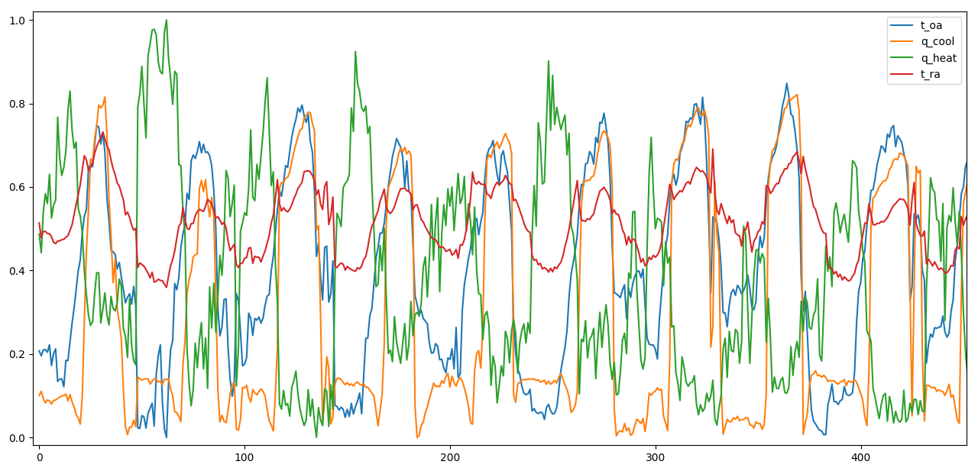
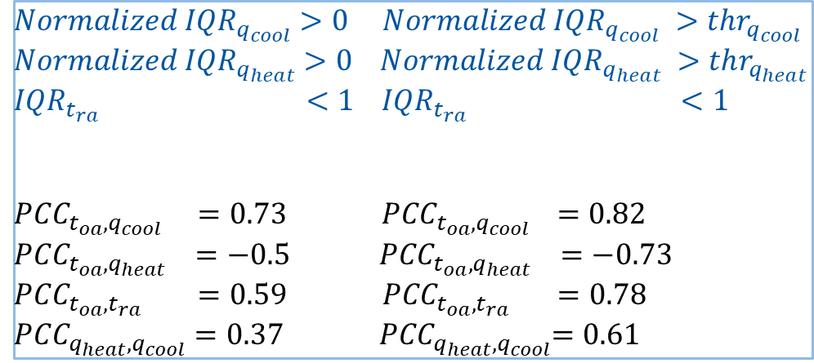
Selection of different building operation periods
Selection of the most correlated observations
Days with higher normalized interquartile range (IQR) have higher Pearson Correlation Coefficient (PCC)
Case 1
Case 1
Case 2 (high IQR)
$${Normalized IQR}_{q_{cool}}>0{ Normalized IQR}_{q_{cool}} >thr_{q_{cool}}$$
$${Normalized IQR}_{q_{heat}}>0{ Normalized IQR}_{q_{heat}} >thr_{q_{heat}}$$
$${IQR}_{t_{ra}} <1{ IQR}_{t_{ra}} <1$$
${PCC}_{t_{oa},q_{cool}} =0.73$ ${ PCC}_{t_{oa},q_{cool}} =0.82$
$${PCC}_{t_{oa},q_{heat}} =−0.5 {PCC}_{t_{oa},q_{heat}} =−0.73$$
${PCC}_{t_{oa},t_{ra}} =0.59$ ${ PCC}_{t_{oa},t_{ra}} =0.78$
${PCC}_{q_{heat},q_{cool}}=0.37$ ${ PCC}_{q_{heat},q_{cool}}=0.61$
Case 2 (high IQR)
Fig. 8. Correlation of the analyzed variables for different thresholds.

Slide 13
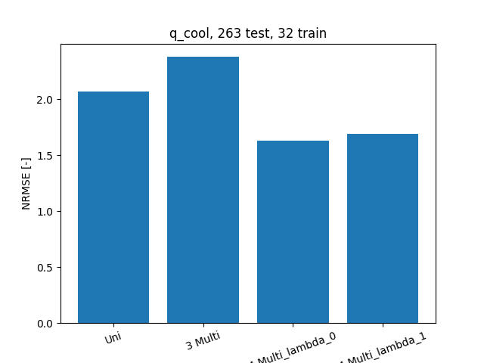
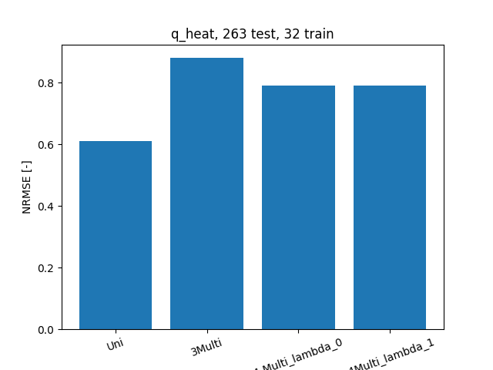
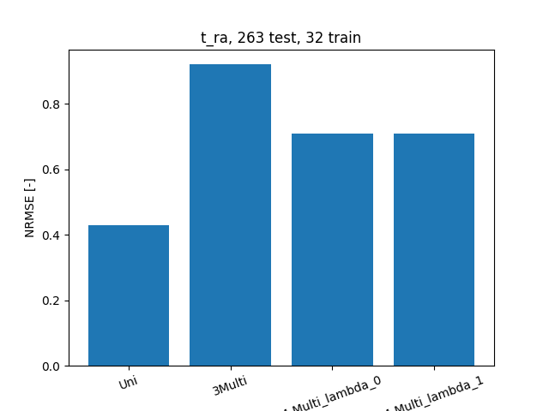
Ablation study (preliminary results): Case 1
Training set: 10% plus data augmentation
PI-DAE has always slightly worst performance
Fig. 8. Performance of different models for different variables. 1st Column: univariate DAE; 2nd Column: multivariate DAE with no outdoor temperature; 3rd Column Multivariate DAE with outdoor Temperature, 4th Column: PI-DAE.

Slide 14
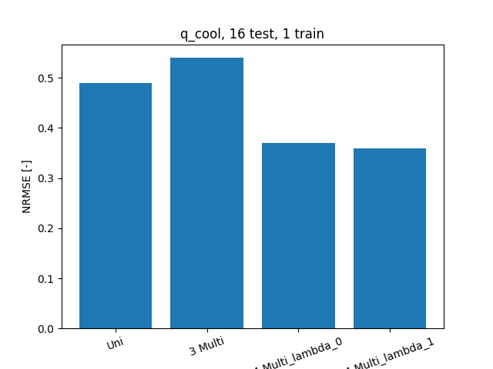
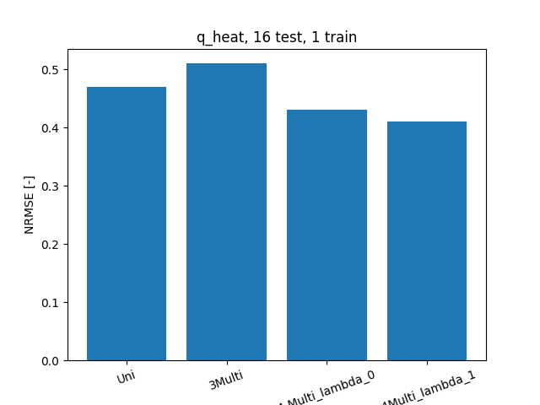
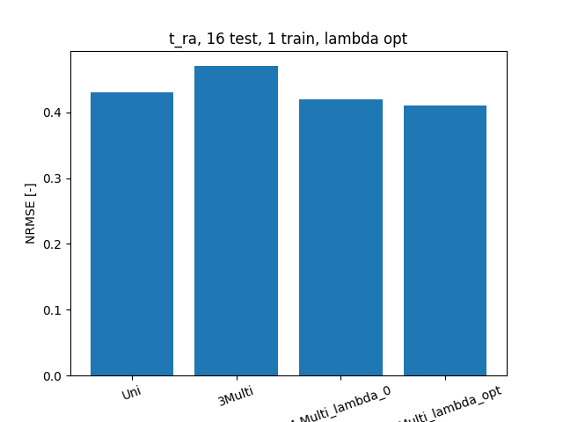
Ablation study (preliminary results): Case 2
Training set: 10% plus data augmentation
PI-DAE has always slightly better performance
Fig. 9. Performance of different models for different variables. 1st Column: univariate DAE; 2nd Column: multivariate DAE with no outdoor temperature; 3rd Column Multivariate DAE with outdoor Temperature, 4th Column: PI-DAE.

Slide 15
Considerations
The preliminary results show that the physics-informed constrain can further fine-tune the performance of the base DAE on highly correlated data and it is therefore a meaningful research direction
Additional work / debugging has to be performed to improve the results

Slide 16
Thank you for your attention!

